Slide 1
DFS -> MSG
Chandler
Jan, 2018

Slide 2
Theory
Validate
Execute

Slide 3
Impulse response
MLS, maximum length sequence, this is the sound you hear when you press calibrate.
So, actually MLS is the stimulus of this feedback system which we can specify amplitude in ALT
DFSInit.init_front = accumulated response on front mic.
It is the response of the feedback path in time domain. Like, it is the voltage output of mic during the calibration.
Accumulated response convolved with the MLS -> impulse response (compensated with some circular delay ect.)

Slide 4
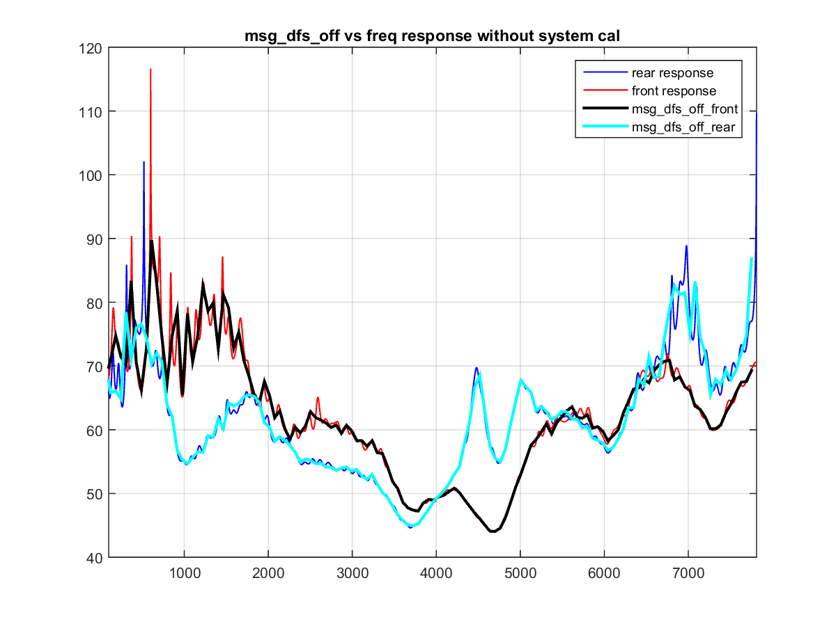
DFSInit.init_resp_front = impulse response on front mic
Impulse response tells us the characteristics of the feedback path (transfer function from receiver to microphone)
We usually deal with the feedback path in frequency domain, and since the impulse response is in the time domain. Then we make an FFT to obtain the frequency characteristics. -> msg_dfs_off (system cal. not included)

Slide 5
Red line in ALT
To obtain MSG in ALT, we transform init_resp_front to frequency domain and included the system and production calibrations (or just take msg_dfs_off + calibration = msg)
In case of dual mic, it is the worse case between front and rear curves that determines msg for each frequency.

Slide 6
Validate
Measure FOG50 & OPL, combine them -> MSG_opl = FOG - OPL
Measure the gain when setting is 0 -> MSG_ALT = msg + gain0
This msg is not equal to the MSG_OPL, because H bridge is not included. Msg here is the maximum gain setting we can set in HI
Compare two MSG

Slide 7
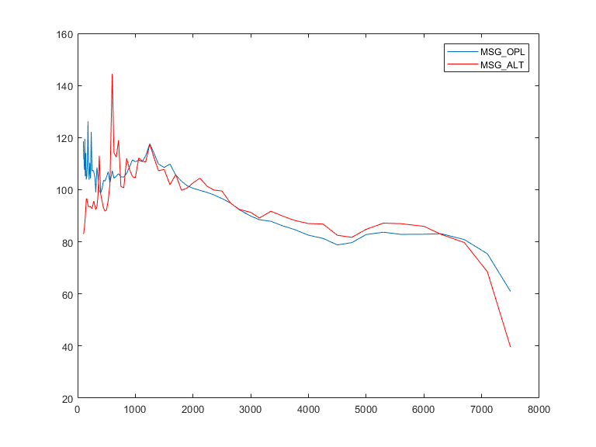

Slide 8
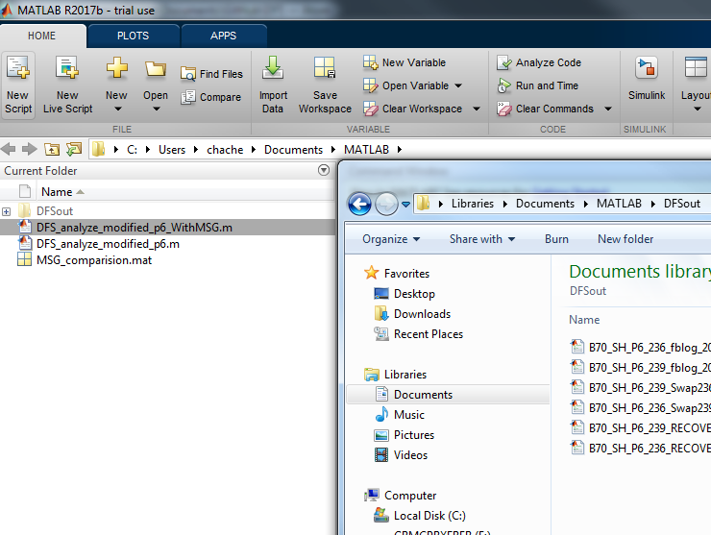
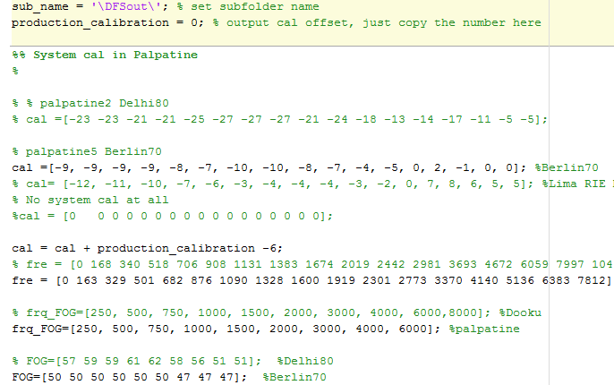

Slide 9
TCdfs
in the preliminary Dooku2 release for Cambridge, one issue found. the coefficients for the feedback filter was not written correctly during TCDFS init.
and this is solved in the following database patch:\\Hearing\Data\Releases\AlgorithmDeliveries\Dooku2\Dooku1Cambridge1\DB Patch (TCDFS + CDI Creation)\RatatoskConfiguration.sdf
The TCDFS in Dooku should be the same as for Palpatine6. The same functionality has been ported.

Slide 10
TCdfs
in AlgolabTest you can only see the MSG for TC in the TelecoilMic1 input mode, when no DFS initialization have been done for the mics. in the latter case you will only see MSG for the mics.
I guess the reason for this is, that the MSG for telecoil is normally much higher and relevant in TelecoilMic1 scenarios

